Slide 1
Guidelines Working Group 1
Step 1: Scoping
Step 2: Design and Feasibility

Slide 2
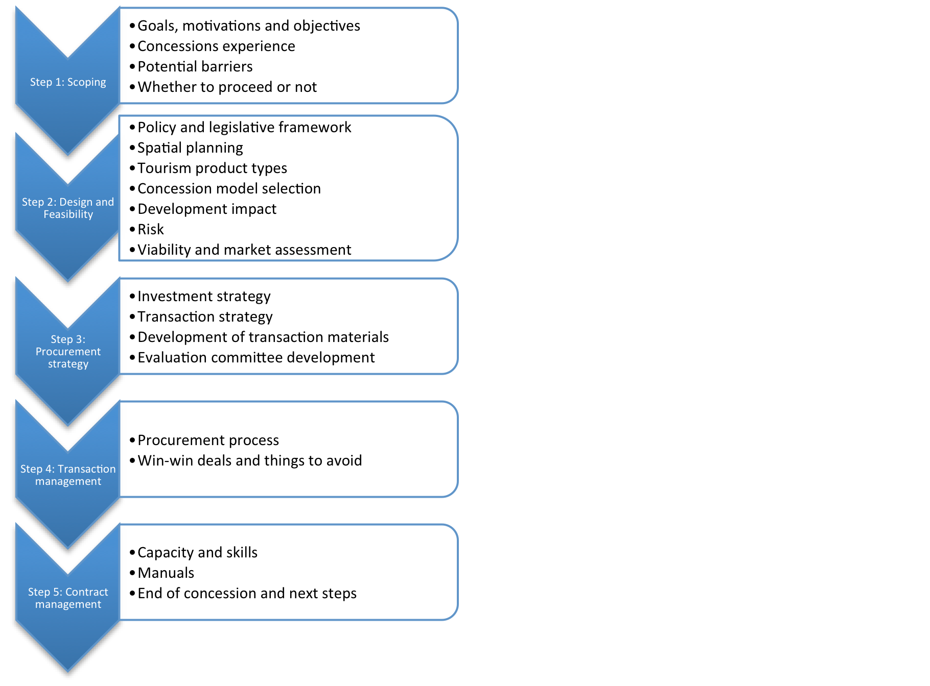
Working group activities:
Work through draft Guideline text
Note alterations and improvements
Suggest case study examples from SADC
Indicate tools that would be useful
Nominate rapporteur for report back

Slide 3
Step 1: Scoping:
Group A: Goals, experience, barriers, to proceed or not
Facilitator: Michael Wright
Step 2: Design and Feasibility:
Group B: Policy and plans, concession model selection, risk
Facilitator: Anna Spenceley
Group C: Product types, viability and market assessment
Facilitator: Roland Vorwerk
Group D: Stakeholder engagement, development impact
Facilitator: Deborah Kahatano

